Slide 1



Pi Kappa Alpha Fraternity
“You Can Help a Brother”
FPO
Recognizing and Responding to Brothers and Friends in Distress
Thea Zunick, Ed.D.
Manager, Community Engagement
The Jed Foundation
For use of approved Pi Kappa Alpha Fraternity members only
Notes:
Welcome! Thank you for being here today. My name is _______ and I am ___________ [offer information about your profession, background, or why you’re facilitating this workshop]. Please enter your first and last name as well as chapter designation into the chat - this is for verifying attendance.

Slide 2
What Is The Jed Foundation?
A brief overview of the vision and comprehensive approach of the foundation

Slide 3

Who is The Jed (JED) Foundation?
JED is a nonprofit that protects emotional health and prevents suicide for our nation’s teens and young adults.
JED partners with high schools and colleges to strengthen their mental health, substance misuse, and suicide prevention programs and systems.
JED equips teens and young adults with the skills and knowledge to help themselves and each other.
JED encourages community awareness, understanding and action for young adult mental health.
https://www.jedfoundation.org/
3

Slide 4


The Jed Foundation & Pi Kappa Alpha Fraternity
The landscape of higher education and the fraternal experience is changing each and every day. Therefore, the Fraternity is emphasizing the importance of preparing the Brotherhood for an increase in stress and anxiety, especially in this upcoming academic year.
This is exactly why the fraternity is partnering with The Jed Foundation. We care about our Brotherhood and know the importance of giving you the tools to be act with integrity and reply on the intellect that you can use to engage with others using high moral character to help a Brother or friend in need.
4
Notes:
Pikes set the standard for integrity, intellect and high moral character.

Slide 5
What To Expect From This Training
Obtain an understanding of the current landscape of mental health in young adults.
Learn how to identify signs of distress in others.
Focus on what you can do to help a Brother or friend in distress and how to take action.
Be provided with resources and links on where to go for more support.
5

Slide 6
So, what exactly IS mental health?
Definitions and examples of what it is and how it relates to college students

Slide 7
Mental health is a state of well-being in which every individual realizes their own potential, can cope with the normal stresses of life, can work productively and fruitfully, and is able to make a contribution to their community.
World Health Organization

Slide 8

How Does This Relate To College Students?

Slide 9
Mental Health in College Students
31% of college students report being diagnosed with or treated for a mental health condition in prior year
Anxiety (23%) and depression (19%) are the most common diagnoses
10.1 % of college students surveyed ( 7.0 % male and 10.7 % female) indicated they had intentionally cut, burned, bruised, or otherwise injured themselves within the last 12 months.
2.7 % of college students surveyed ( 3 % male and 2.4 % female) indicated they had attempted suicide within the last 12 months.
Symptoms are common. At some point in the past year:
  20% reported experiencing serious psychological distress
  50% felt lonely
  63% felt overwhelming anxiety
  45% had challenges with personal appearance
  35% had challenges with the health of someone close to them
  40% do not seek help
  80% feel overwhelmed by their responsibilities
Source: NCHA fall 2019
Notes:
Source: https://www.acha.org/documents/ncha/NCHA-III_Fall_2019_Undergraduate_Reference_Group_Executive_Summary.pdf

Slide 10

The Top Mental Health Challenges Facing College Students
Depression
Anxiety
Suicide
Eating Disorders
Addiction
Left untreated, these issues can become debilitating and even life-threatening.
10

Slide 11
Young adults experience a broad spectrum of feelings
grappling with insecurities
struggling in work/school
anxiety about future, college, etc.
romantic relationships/breakups
friend “drama”
issues with parents/family
more complicated family issues, e.g. divorce
sickness or death in family
hopes/aspirations barriers — e.g. job loss
struggling with sexuality
drug/substance misuse
self-harm
depression
anxiety
Source: JED, Ad Council, Droga5, Magnetic, AFSP research

Slide 12

Your generation is poised to lead on efforts to support mental health.
You're leading the charge for greater acceptance of all.
You're talking about mental health more than anyone else and they know it is as important as physical health.
You want honest, relatable representations of mental health.
You naturally want to help your friends and you go to their friends first when you are in distress.
Source: Cassandra Report 2015; Droga5 Point Lab interviews

Slide 13
Despite their desire to help, with emotionally complex scenarios many young adults cite clear barriers to engaging
higher perceived level of toxicity & risk
Mistakes could have bigger impacts
protect themselves
doubting instincts
protect friendships
doubting impact
inaction
fear of irreparable damage or offense
friend’s behavior becomes unclear

Slide 14

So, what do these barriers look like?
Don’t want to feel like you are getting in the middle of an argument/situation
Getting your friend to admit it/ come around
Not knowing what to do/say
Risk of friend getting mad at you
Not having personal experience in the matter
Sometimes you just DON’T KNOW, people hide it well
Sometimes you need to give people space
You’re angry yourself!
A fear that you could be overreacting
Don’t feel it’s your place to intercede
14

Slide 15
Fraternity & Sorority Life
Unique landscape of fraternity and sorority life and the opportunities that results from this
15

Slide 16
Challenges and Opportunities
Fraternal organizations have specific opportunities and challenges when it comes to mental health. What do you think those are?
In breakout groups discuss the following:
What are the different challenges for fraternal organizations when it comes to mental health?
What are the different opportunities for fraternal organizations when it comes to mental health?
16

Slide 17
Current Landscape of Fraternal Life
Opportunities
Challenges
Fraternities are predicated on mutual connectedness and support
These ideas promote mental health and safety in groups when expressed positively
Tight social group members know each other well-opportunity to identify and support members who are struggling
Positive values and culture communicated by group leaders can have powerful influence on group members
Group culture can at times bring out the worst instincts in members (think “Neighbors”)
Impulse and pressure to cover up problems can be more powerful in tight knit group (group secrets and pressure not to breach group confidences)
Tight groups can develop/increase mistrust of outsiders (“us vs. them”)
17

Slide 18
Remember, We Are All Human
People have problems all the time
Problems are an inevitable part of growing up
Dealing with problems and personal challenges provide us with opportunities to grow, mature and learn about ourselves and the world
Many times we can work our troubles out with help from friends, family or by ourselves
Not every problem requires professional help
Further along in this presentation we’ll give you some simple guidelines to help you decide if you might need professional help managing a problem
18

Slide 19
Recognizing Distress

Slide 20

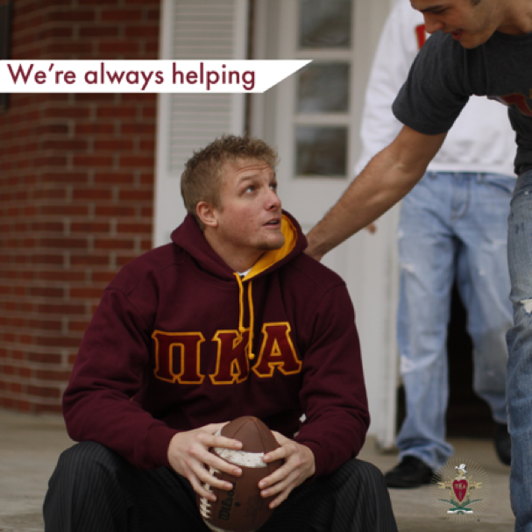
Distress:
What it is and
What it isn’t
Is: Sometimes a result
of circumstance
Is not: Always caused by a
clinical mental illness
Is: Deserving of help and care
9

Slide 21
First Rules
You don’t need to know exactly what is wrong-just that there is a problem-and that is intuitive
It is courageous and sensible to ask for (and offer) help when it is needed
Trust your gut-if you think there is a problem, it’s a good chance there is
Use your resources and contacts-know your backup resources/system and use them/it
If concerned, always consult
21

Slide 22
Behavioral Signs to Notice
Changes:
Appearance
Mood
Speech
Behavior
Relationships
Academic Performance
You don’t need to be an expert/clinician to notice! You just need to trust your observations. CHANGE is the most important clue!
22

Slide 23

Signs To Look for in a Digital Environment
Posting comments such as “I hate myself,” “I suck at everything”, or “ I want to die or kill myself”.
Writing a lot or posting about suicide, heath, or self-harm.
Posting dark poetry or quotes, disturbing songs or videos
Using hashtags that are connected to worrisome trends
Using sad, distressed emoticons or emoticons of destructive things such as guns, knives, etc…
When they stop responding to your messages
Posting about engaging in high-risk behavior (i.e. binge drinking, illegal drug use)
23

Slide 24
Advice from students about how to support them when they are struggling:
Do
Treat me normally, without judgement
Be accepting of my struggle
Use an understanding or empathetic tone
Open up conversation, offer to listen
Offer invitations, activities, social inclusion
Keep checking in, make yourself available
Set boundaries
Show me that you care/value me
Ask open-ended questions
Take care of yourself
Involve experts when necessary
Don’t
Freak out about OR make light of my situation
Try to solve my problems
Use an accusatory or condescending tone
Demand conversation
Get offended if I don’t accept
Disappear on me, without explanation
Make me feel like a burden
Give me false praise
Interrogate me
Make it about you
Turn people against me; gossip about me
24

Slide 25
You may want to consider PROFESSIONAL help if….
Problems are:
Too intense
Lasting too long
Too disruptive
Getting worse
Recurring or following the same pattern
Dangerous (self or others)
Your gut tells you something isn’t right
Notes:
Think about a time you had a headache or stomach ache. These things happen all the time and we don’t always call our doctor or go to a hospital emergency room when we have them. But we usually will call or visit a doctor if problems are different from usual run of the mill headache or are very intense, getting worse, interfering with functioning, lasting too long-just like with mental health problems!

Slide 26
Think about a time you had a headache or stomachache.
These things happen all the time and we don’t always call our doctor or go to a hospital emergency room when we have them. But we usually will call or visit a doctor if problems are different from usual run of the mill headache or are very intense, getting worse, interfering with functioning, lasting too long-just like with mental health problems!
Notes:
You know when to see a doctor about a health concern, whether through a thought process or intuition. The
same thought process and intuition can be applied when deciding when to get help for mental health. You
don’t need to know what the problem is to know that someone needs help.

Slide 27
Seizing that Awkward Moment

Slide 28

Seize the Awkward:
A digital campaign from: JED, AFSP, and Ad Council
Everybody experiences mental health issues in different ways.
Starting a conversation with a Brother, friend, family member, really anyone… can be awkward. It’s awkward for the person asking if their friend is OK and it’s awkward for the friend in need.
This campaign asks young adults to recognize and seize this awkwardness to support their friends.

Slide 29
What Is The Message?
It’s about the awkwardness of starting the conversation about mental health.
It shows that this is just a moment—it isn’t everlasting.
It talks about the good that comes from seizing the temporary awkwardness.
It maintains the relatable humor that our audience loves.
It tackles mental health head on, not shrouding the topic in indirect language

Slide 30
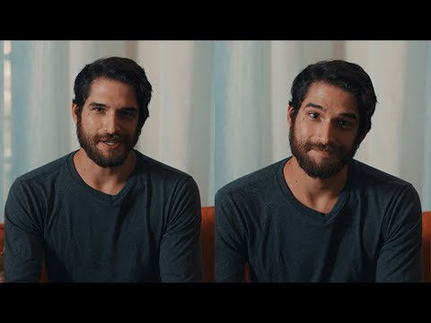
Notes:
https://www.youtube.com/watch?v=9GlhsZTVAQM

Slide 31
How Do You Express Concern?

Slide 32




Seize the Awkward Campaign
Notes:
https://www.youtube.com/watch?v=r47l4eUU1bc

Slide 33
Expressing Concern
Explain why you are concerned (be specific, “You have been missing lots of classes, look sad all the time, falling asleep…”)
Show compassion (‘I am worried about you..”)
Listen (You don’t have to solve problems!)
Know your own limits (if it is requiring time, effort, concern on your part that feels beyond what you can do, you probably need to get others involved)
Validate 🡪 Appreciate 🡪 Respond/Refer
Notes:
*if you explain why you are concerned it is harder for your friend to dismiss your observations and just say all is ok if it’s not
** expressing concern by telling your friend you are concerned or worried about them is helpful in itself. It lets them know you are thinking about and supportive of them
*** if you are experiencing the need to be so helpful that you starting to compromise your own performance, health or safety, then this is probably a bigger problem than you can help with.

Slide 34
What To Say When You Reach Out….
Keep it casual. Relax: think of it as a chill chat, not a therapy session.
Listen up. Let them take the lead.
Avoid offering advice or trying to fix their problems.
Let them know it’s OK to feel the way they do.
Ask open-ended questions. Help them to talk, not just say “yes” or “no”.
Let them open up at their own speed.
Don’t demand answers or force them to say anything they’re not ready to.
Encourage them to talk to an expert.
Tell them you won’t ever judge them.
Let them know that this won’t change how you feel about them.
Ask them if they have seen a doctor.
Make yourself available. Be the friend they can rely on.
Reference: Seize The Awkward Campaign

Slide 35
Challenges in Expressing Concern
If someone is not obviously or immediately in harm’s way and won’t accept your help:
  Try to keep the lines of communication open
  Check in with professional staff or other support options (counseling, student affairs)
  Follow up
If someone is having an emergency and refuses help, involve the appropriate college/university professionals or call 911.

Slide 36
Concerned About a Friend or Brother and Suicide?

Slide 37
Suicide concerns
50-75% of people who attempt suicide talk about their suicidal thoughts, feelings and plans before they act (most often with a friend*)
*listening to your Brother/friend and taking them seriously is always a good idea

Slide 38
Suicide Facts
People who attempt suicide usually do give warning signs.
  80% of people who die by suicide gave verbal and/or nonverbal warning signs.
Mentioning suicide will not lead someone to attempt suicide.
  Asking someone about their suicidal feelings may make the person feel relieved that someone finally recognized their emotional pain.
Most suicidal people have not decided they want to die, and there are things that can be done about it.
  Most suicidal people are ambivalent; that is, part of them is saying, “I want to die,” but part of them is saying, “I want to live.”
Most people who talk about suicide are not being manipulative or trying to get attention.
  People who talk about suicide are genuinely distressed and should be taken seriously.

Slide 39
Signs to Notice
  Talking about wanting to end it all
  Giving away personal possessions
  Expressing guilt, hopelessness or desperation
  Withdrawal from everyday life and chapter life
  Expressing intense anger
  Asking about or actively seeking access to deadly means
  Changes in use of substances
  Posting “goodbye” on social media

Slide 40
What to Do
If someone mentions suicidal thoughts:
Take them seriously
Find out where they are
Find out if they have done anything up to now to harm themselves
Ask if they are willing to accept help?
If you are with them, stay with them if it is safe to do so
Calmly get the information you need to get them help
Get them connected to a mental health professional or crisis service as soon as possible

Slide 41
Additional Preventative Efforts
Make sure you are aware of campus medical amnesty policies around alcohol or drug emergencies
  Medical Amnesty Policies are laws or acts enacted protecting from liability those who seek medical attention as a result of illegal actions
  Check with your Fraternity & Sorority Advisor on your campus to learn about your policy
Talk about mental health openly in the fraternity, especially during recruitment and member education opportunities
Work to create a culture of positive connections, support, and care amongst the fraternity
Notes:
Note about medical amnesty policies: most campuses have a policy where they lower or remove disciplinary sanctions if you get help or help a friend in crisis because of alcohol or drugs

Slide 42
Quick Check In
Share something new that you learned about suicide.
What is an example of something you can say to someone who you suspect is struggling with mental health?
What is/are the benefit(s) from reaching out to someone when you suspect they are struggling with mental health?
Notes:
If doing this live, ask the following questions:
Share something new that you learned about suicide.
What is an example of something you can say to someone who you suspect is struggling with mental health?
What is/are the benefit(s) from reaching out to someone when you suspect they are struggling with mental health?

Slide 43
What Are Your Resources?

Slide 44
Know Your Resources
College/University Counseling Center and Health Services
  Phone for emergency/crisis during & after business hours
College/University Behavioral Intervention Team or CARE Team
  How to report a student of concern
College/University Public Safety and Police (saved in your phone)
National Crisis Hotlines
  Crisis Text Line 741-741
  National Suicide Prevention Lifeline 1-800-273-8255(TALK)
  Trevor Project for LGBTQ+ 1-866-488-7386

Slide 45
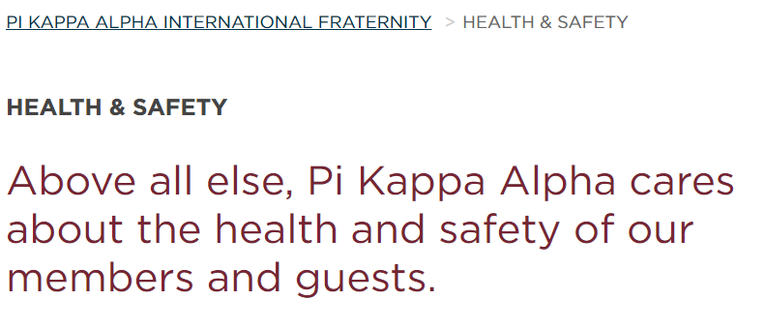
PIKE Resources
PIKE Website
Leadership Consultants
Alumni & Volunteer Advisors
Campus Advisors

Slide 46

Pike Lifeline - http://pike.ulifeline.org/

Slide 47

Wrapping Up: Personal Reflection
Think about a time you experienced a serious problem or a crisis. What were your thoughts and feelings during this time?
Think about what you did, how you acted to deal with the problem or crisis. Was what you did helpful or unhelpful? Were others helpful?
What about what they did helped and what didn’t?
Notes:
Think about a time you experienced a serious problem or a crisis. What were your thoughts and feelings during this time? Think about what you did, how you acted to deal with the problem or crisis. Was what you did helpful or unhelpful? Were others helpful? What about what they did helped and what didn’t?

Slide 48

"For the establishment of friendship on a firmer and more lasting basis; for the promotion of brotherly love and kind feeling; for the mutual benefit and advancement of the interests of those with whom we sympathize and deem worthy of our regard; We have resolved to form a fraternity, believing that, thus we can most successfully accomplish our object."
Name and contact info enter here.

